Slide 1


Uber Company
UBER’S ANALYSIS
Present by Saber Ali

Slide 2



TODAY'S AGENDA
1
Introduction
5
Demand on the basis of Base
2
Peak Days
6
Activity variation by Base
3
Peak Hours
7
Concentraton by Hour
4
Demand by Area
8
Peak Weeks

Slide 3

INTRODUCTION
Uber is a global technology company that connects riders with drivers through
A mobile app, revolutionizing how people move in cities by offering convenient,
On-demand transportation.
In this project we are going to analyse the data of September month of Uber. We will see how this project can disrupt our business in the next month.

Slide 4

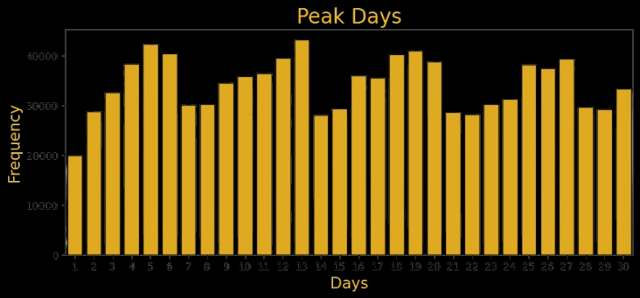
From the graph, we can see that the number of rides fluctuates throughout the month. There are periods of high demand, likely due to factors such as weekends, holidays, or special events, and periods of low demand, likely due to factors such as weekdays or less popular events. The highest number of rides occurs around September 13, 2014, while the lowest number of rides occurs around September 29, 2014.
Overall, the graph suggests that the demand for Uber rides is not constant throughout the month. There are periods of high demand, likely due to factors such as rush hour or popular events, and periods of low demand, likely due to factors such as off-peak hours or less popular events.

Slide 5


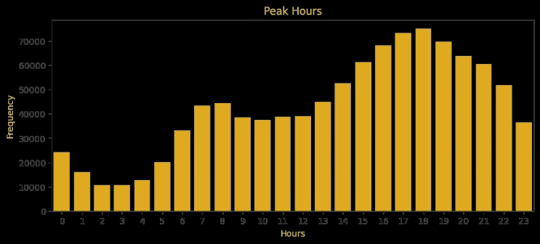

Trends BY HUORS
From the graph, the number of rides generally increases from the early morning hours, peaks between 5 PM and 9 PM, and then decreases towards the late-night hours. The busiest hour for rides is 7 PM, followed by 8 PM and 6 PM. The least busy hours are 1 AM, 2 AM, and 3 AM.
Overall, the graph suggests that most people take rides during the evening hours, likely for commuting to and from work or for leisure activities.

Slide 6
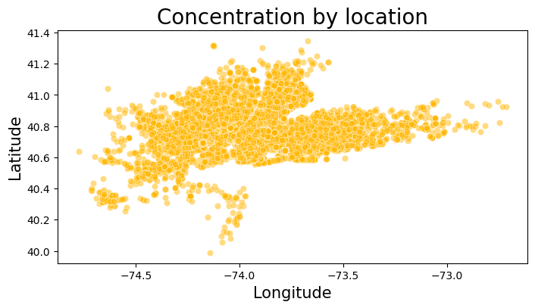
Trends by Area
Latitude and Longitude Influence: The distribution of concentrations seems to be influenced by both latitude and longitude. There appears to be a general trend of higher concentrations in certain latitude ranges or longitude bands.
High Concentration Areas: The most prominent cluster is located around the latitude of 41.0 and longitude of -73.5. This area likely represents a region with significantly higher concentrations compared to other areas on the map.
There are sparser clusters of data points in other regions, indicating lower concentration levels in those areas.

Slide 7
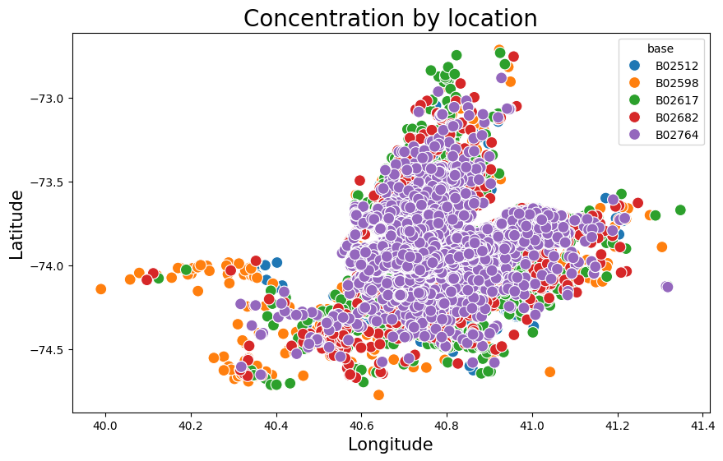
Demand on the basis of Base
From the graph, the number of rides varies significantly between different bases. Base B02617 has the highest number of rides, followed by B02598 and B02682. Base B02512 has the lowest number of rides.
Overall, the graph suggests that there is a significant disparity in the number of rides between different Uber bases. This could be due to a variety of factors, such as the location of the base, the availability of drivers, and the demand for rides in the area.

Slide 8
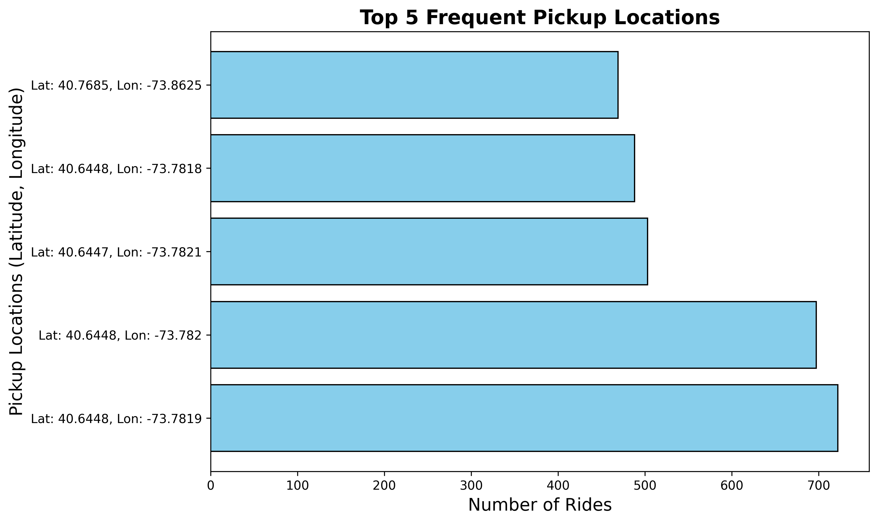
Demand on the basis of Base
From the graph, the pickup location with the highest number of rides is (40.6448, -73.782), followed by (40.6448, -73.7819), (40.6447, -73.7821), (40.6448, -73.7818), and (40.7685, -73.8625).
Overall, the graph suggests that there are certain areas in the city that are more popular for Uber pickups. This could be due to a variety of factors, such as the location of popular attractions, business districts, or residential areas.

Slide 9
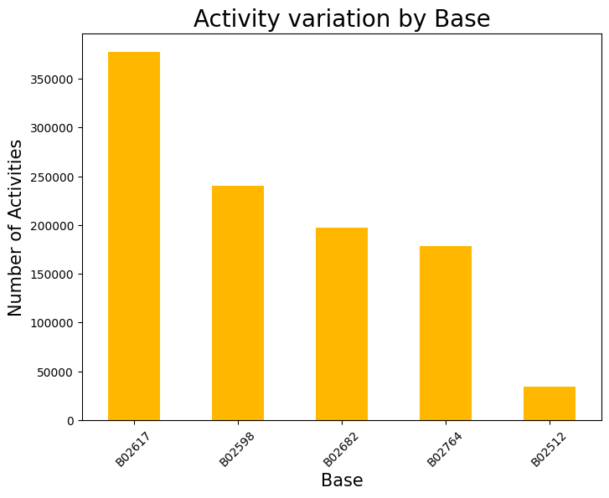
Activity variation by Base
This matrix provides a snapshot of various success metrics for our company, including revenue growth, customer satisfaction, market share, employee retention, innovation, and brand reputation.

Slide 10
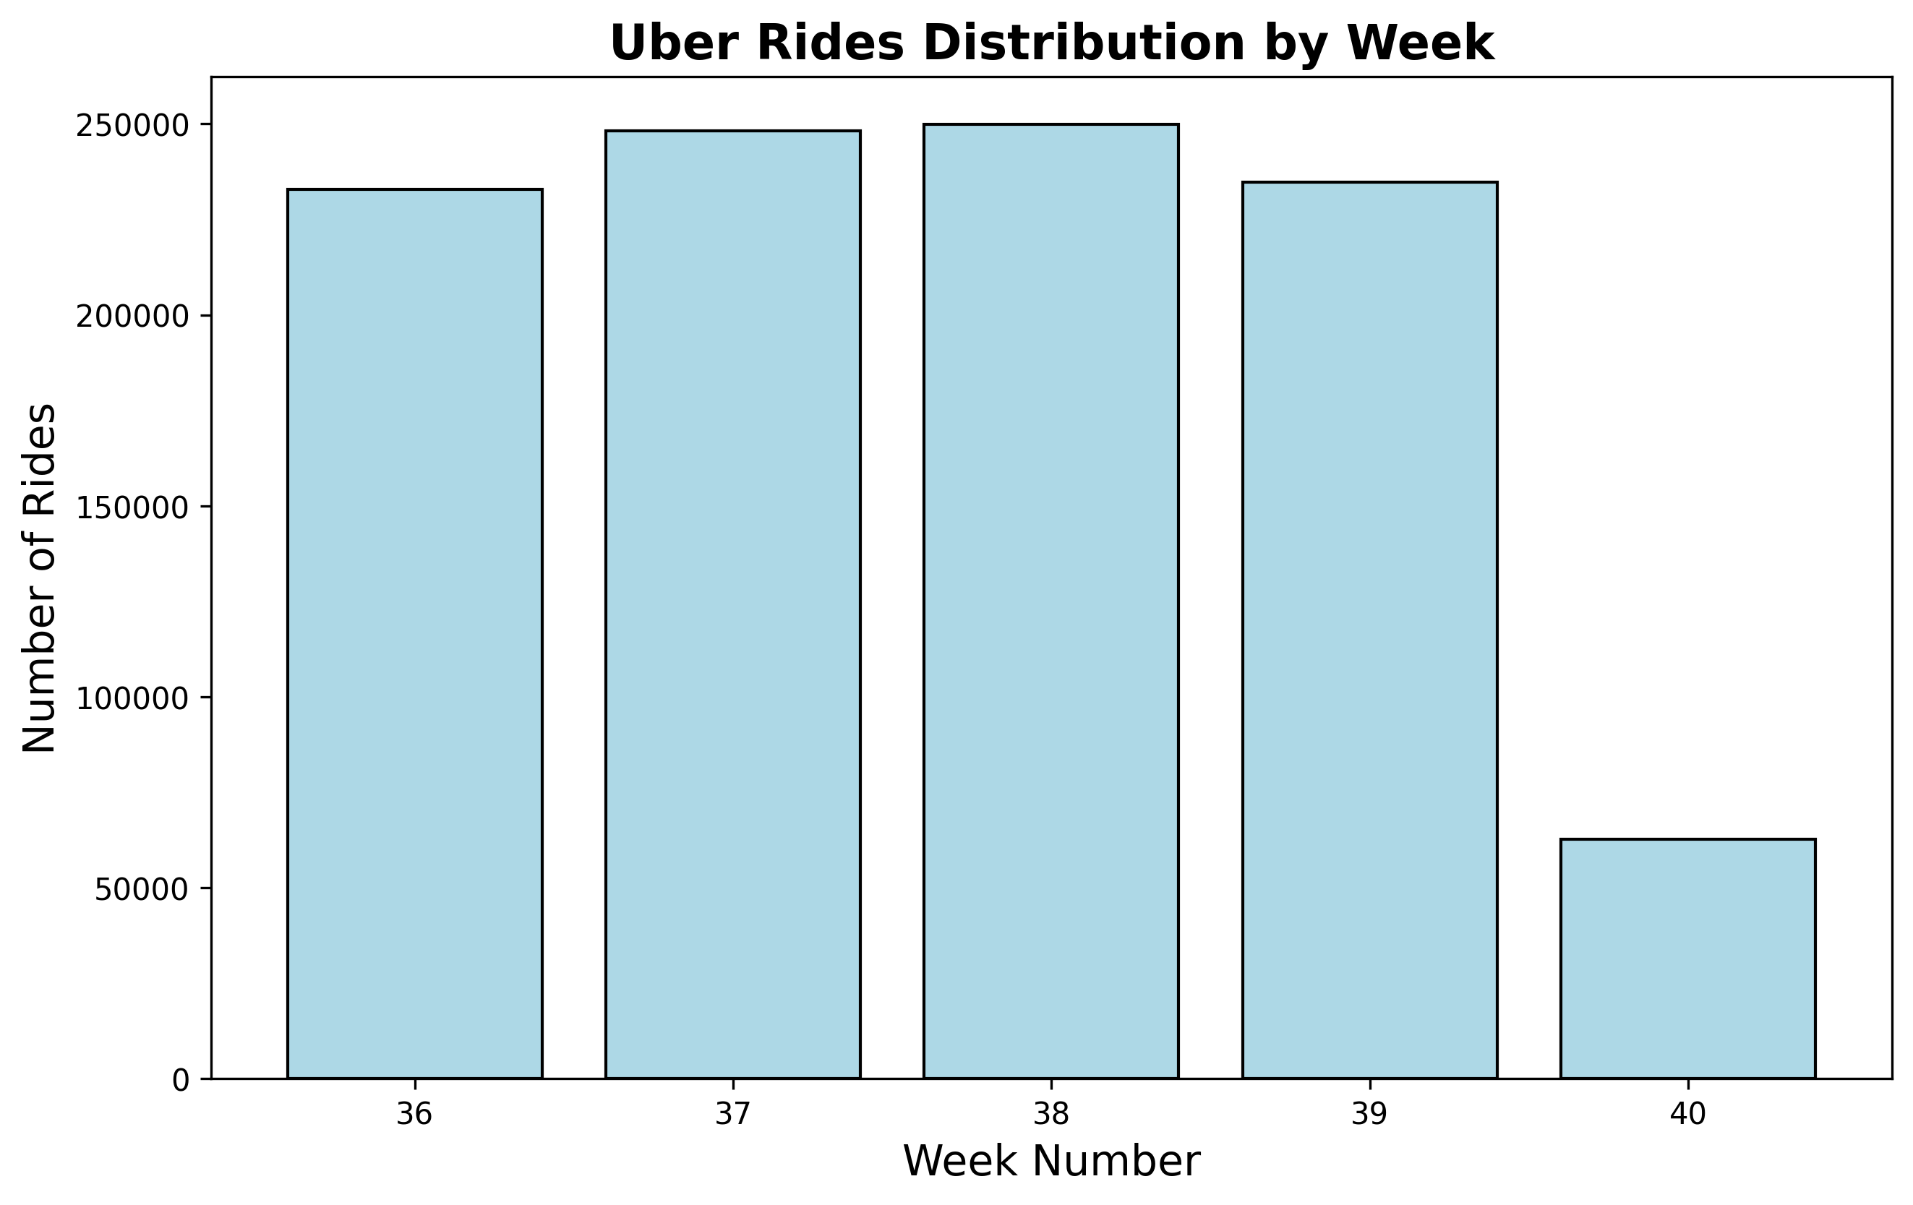
ACCOMPLISH BY WEEK
From the graph, the number of rides varies significantly between different weeks. Week 38 has the highest number of rides, followed by Week 37 and Week 36. Week 40 has the lowest number of rides.
Overall, the graph suggests that there is a significant disparity in the number of rides between different weeks. This could be due to a variety of factors, such as holidays, special events, or seasonal changes.

Slide 11
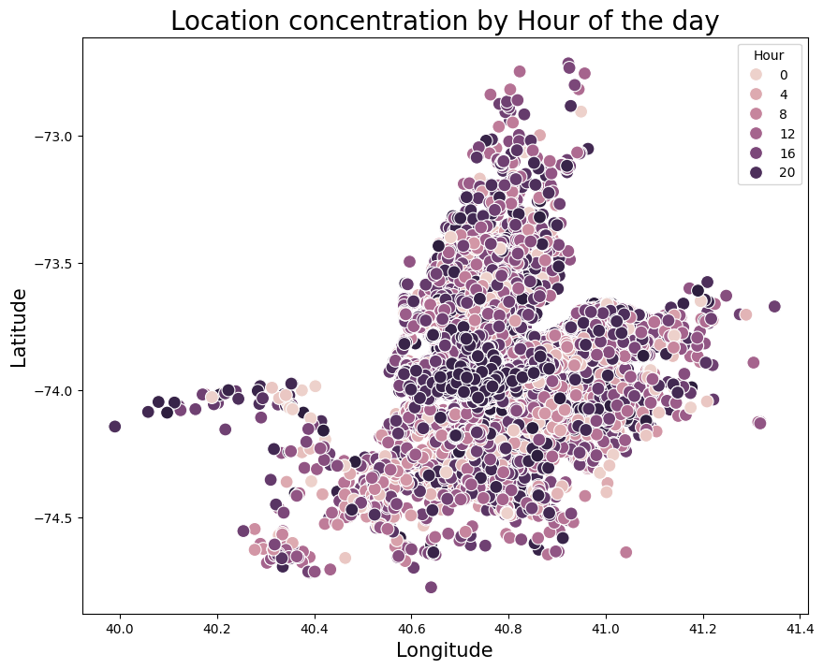
Implications and Further Analysis
Urban Planning: Understanding hourly location concentrations can inform urban planning decisions, such as optimizing public transportation routes, allocating resources, and designing infrastructure to accommodate peak activity periods.
Business Analysis: Businesses can use this information to identify optimal operating hours, target marketing efforts, and allocate resources more effectively.
Social Science Research: Researchers can explore the underlying factors driving these temporal and spatial patterns to understand human behavior, social interactions, and urban dynamics.
Hourly Location Concentration Analysis

Slide 12
Uber’s
THANK YOU
for your time and attention
Present by Saber Ali

